Slide 1
Fire modeling and satellite remote sensing update
Jan Mandel, University of Colorado Denver
Adam Kochanski, James Haley, Angel Farguell, Lauren Hearn, Evan Ellicott, Kyle Hilburn
FUEGO October 16, 2018

Slide 2
HRRR forecast
WRF-SFIRE components
Data assimilation
Data assimilation
Data assimilation
RAWS fuel moisture stations
Satellite moisture sensing
VIIRS/MODIS fire detection
Notes:
Comment on scales. HRRR, comput resources
1 min = 2:30 cumulative

Slide 3
Data from the 2011 Las Conchas Fire
MODIS detections and reported infrared perimeters

Slide 4
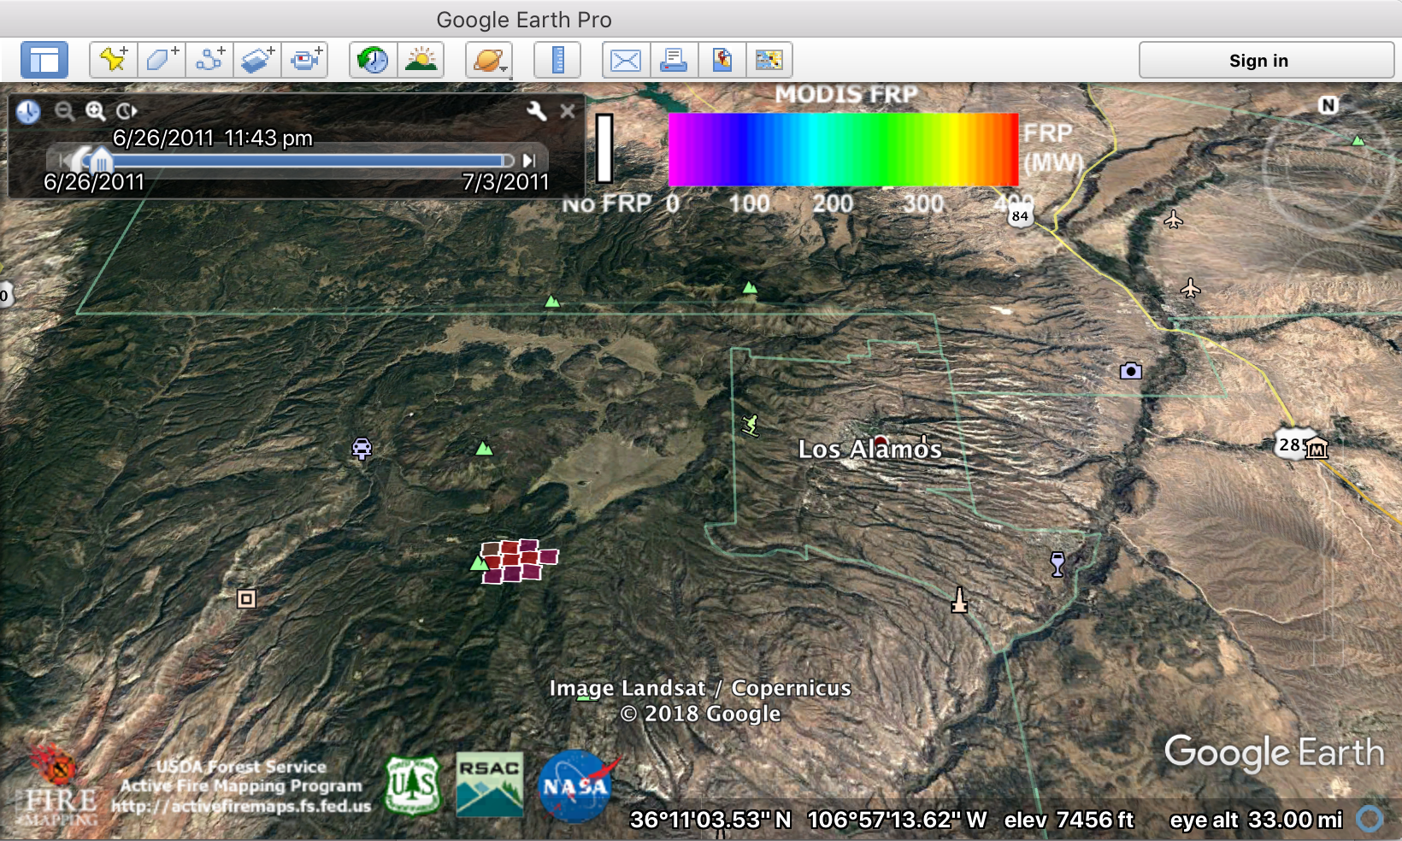

Slide 5
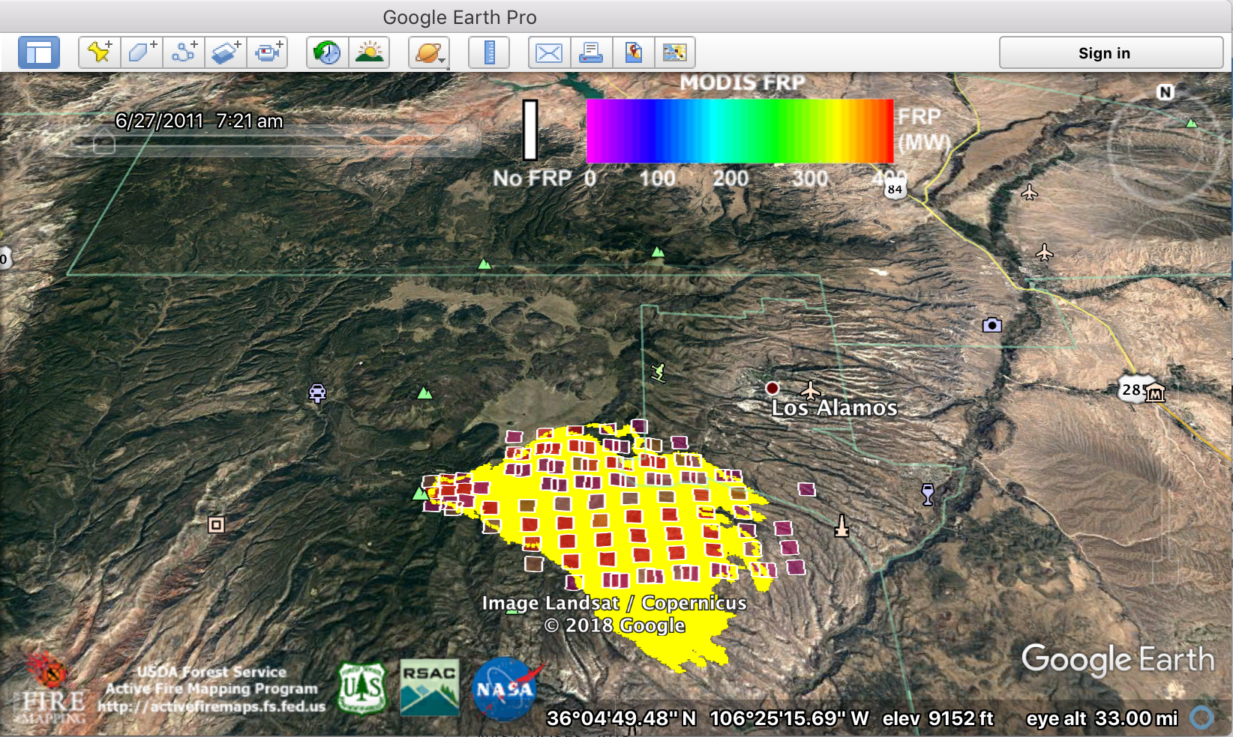

Slide 6
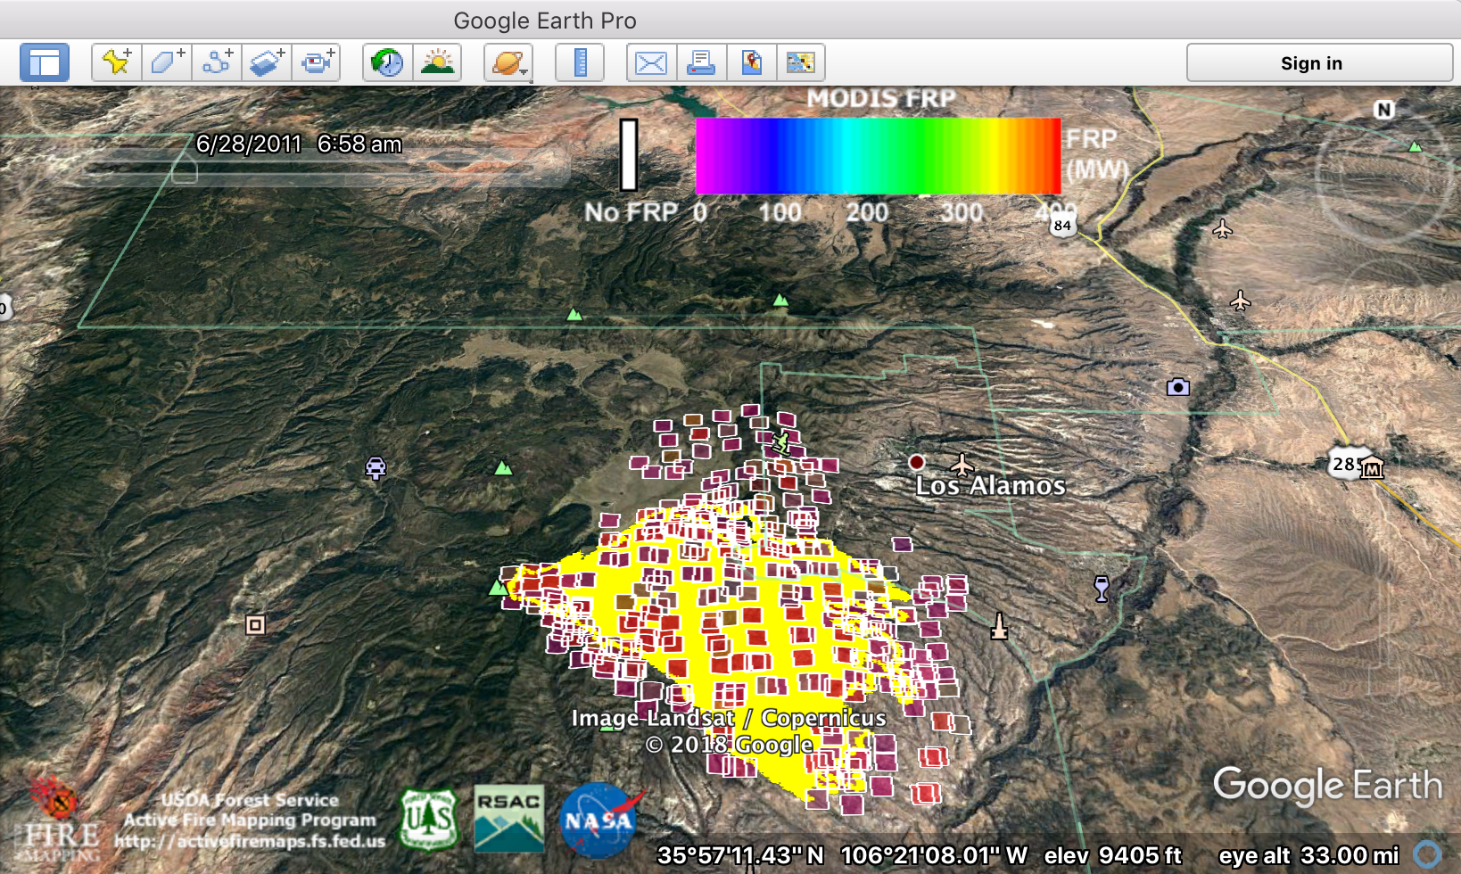

Slide 7
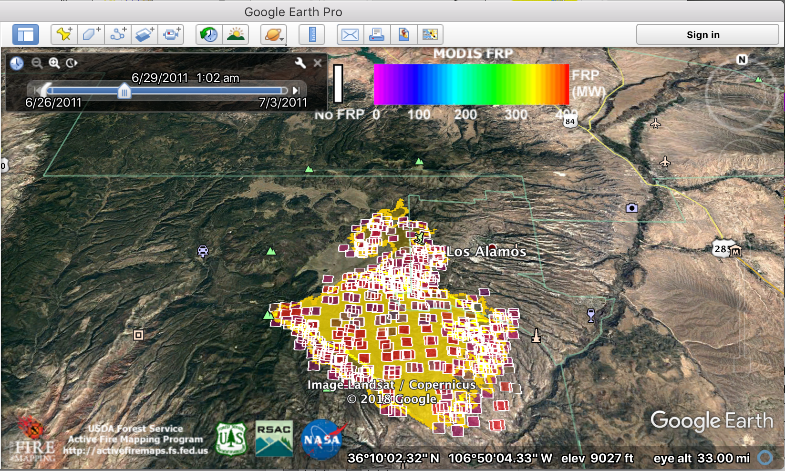

Slide 8
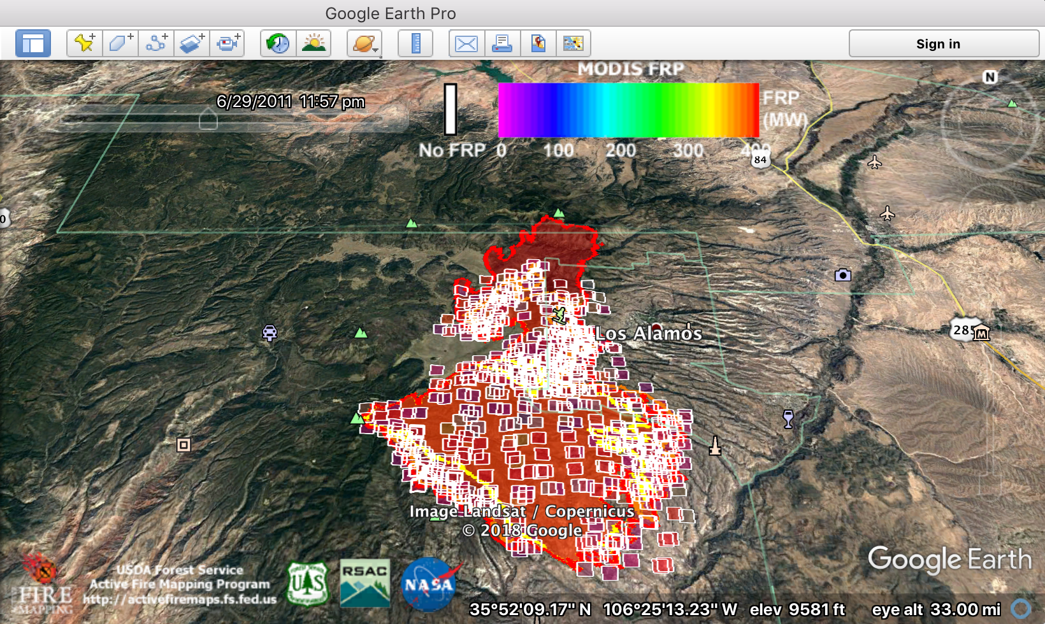

Slide 9
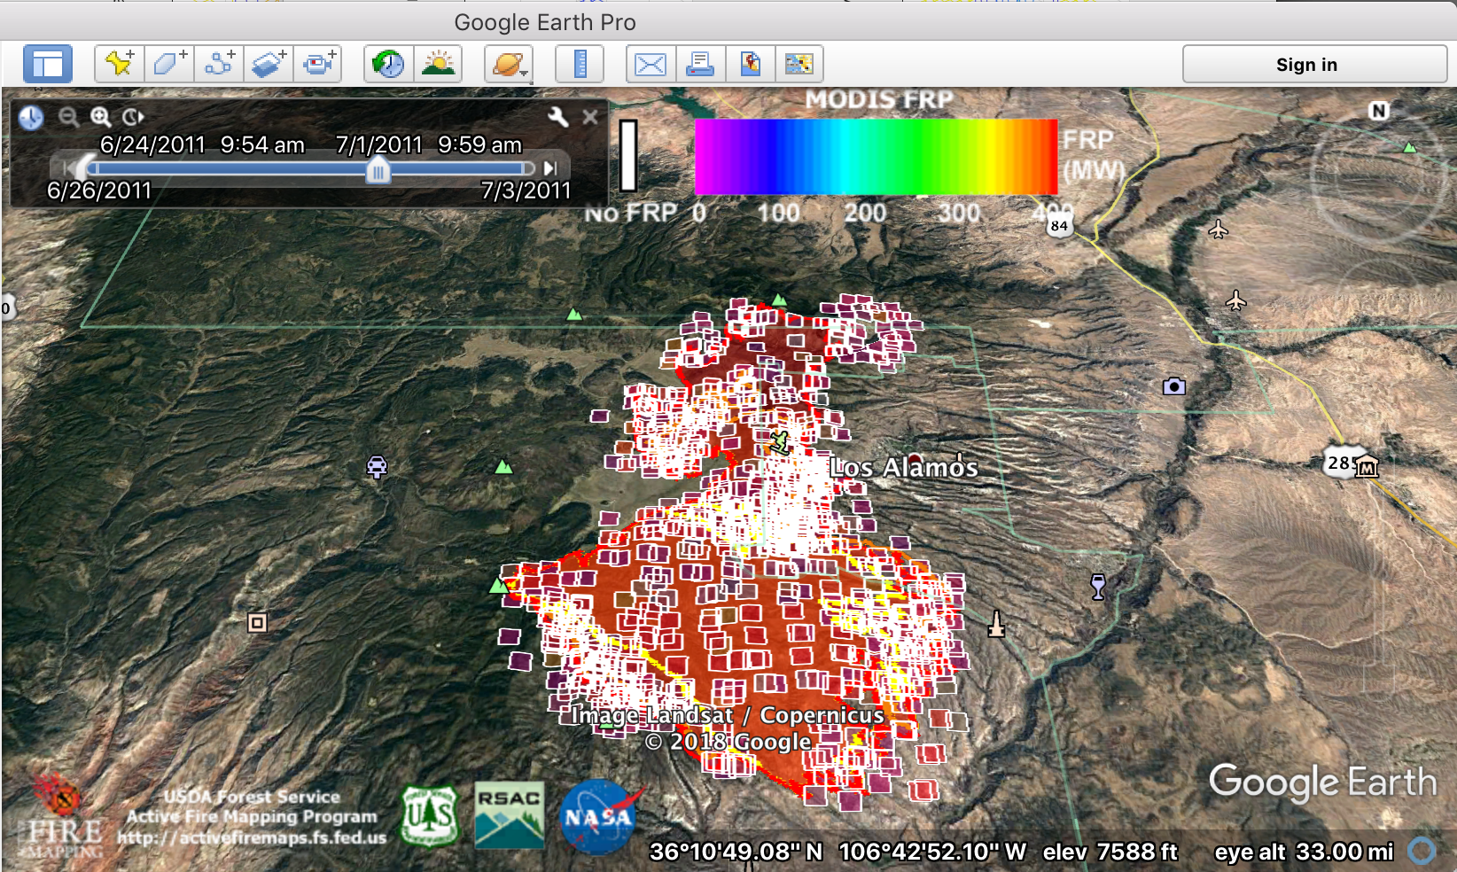

Slide 10
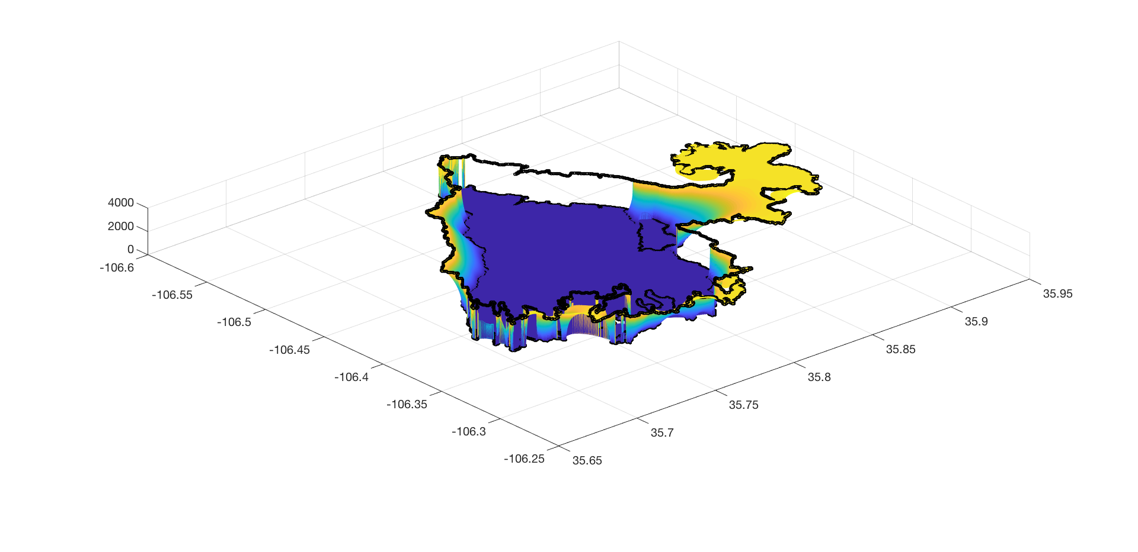
Interpolation of fire arrival time and perimeter start
Reply fire progression instead of spread model
Generate heat fluxes to spin up the atmosphere
Start simulation from the perimeter with consistent fire-atmosphere state

Slide 11
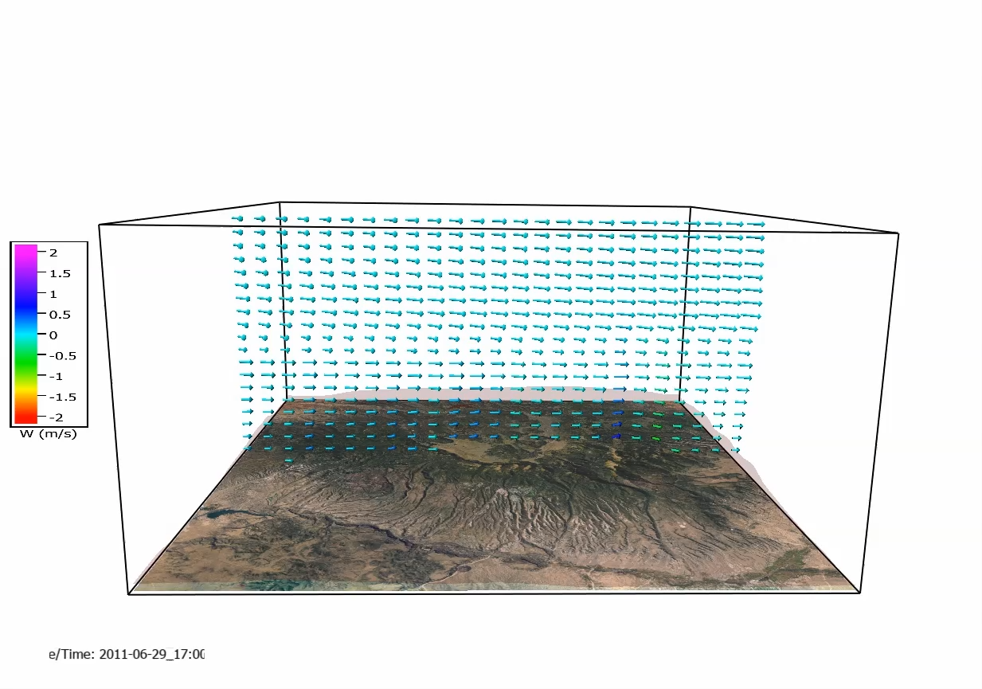

Slide 12
Estimate fire arrival time from satellite data:
Estimate the fire arrival time as a continuous spatial field from relatively coarse and infrequent satellite observations
Light-weight, large area, no fire-spread simulation, no fuel models
Use in:
Fill-in missing pixels for smoke estimation
Automatic ignition and spin-up of WRF-SFIRE

Slide 13
Idea
In the absence of other information, assume fire continues propagating with same rate of spread and direction
Background state = constant gradient of the fire arrival time, modify by data
First fire detection at a location => upper bound on the fire arrival time
Last detection of clear ground with no fire => lower bound

Slide 14
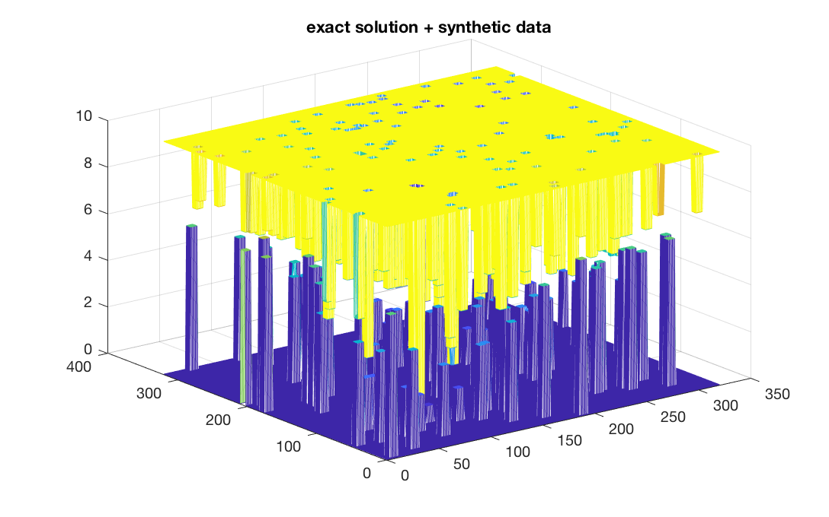
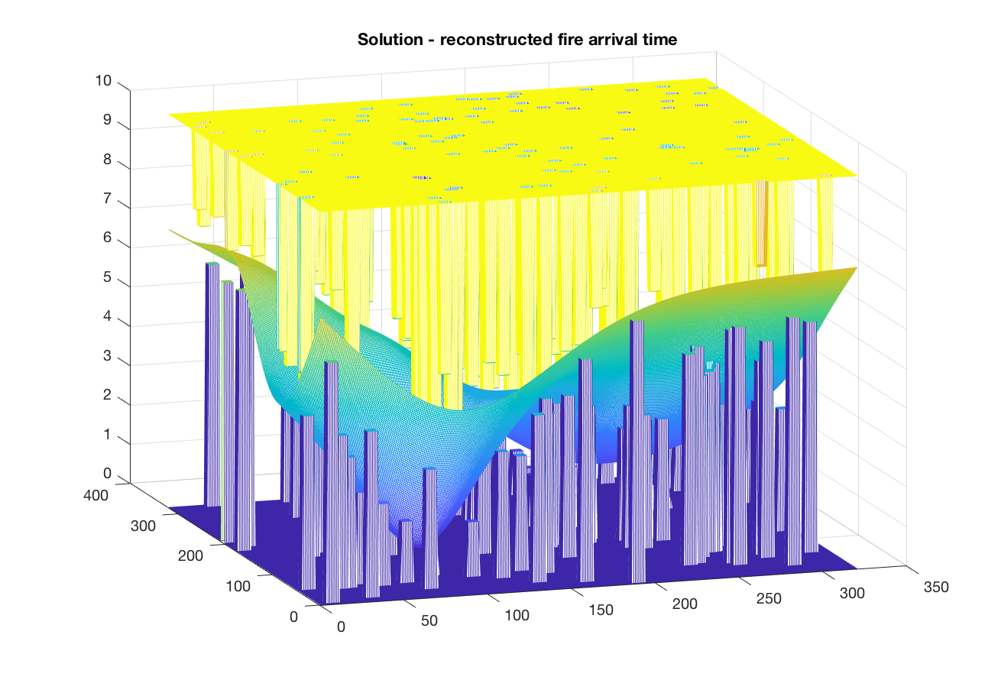
First test: Synthetic data
Synthetic data Reconstructed fire arrival time

Slide 15
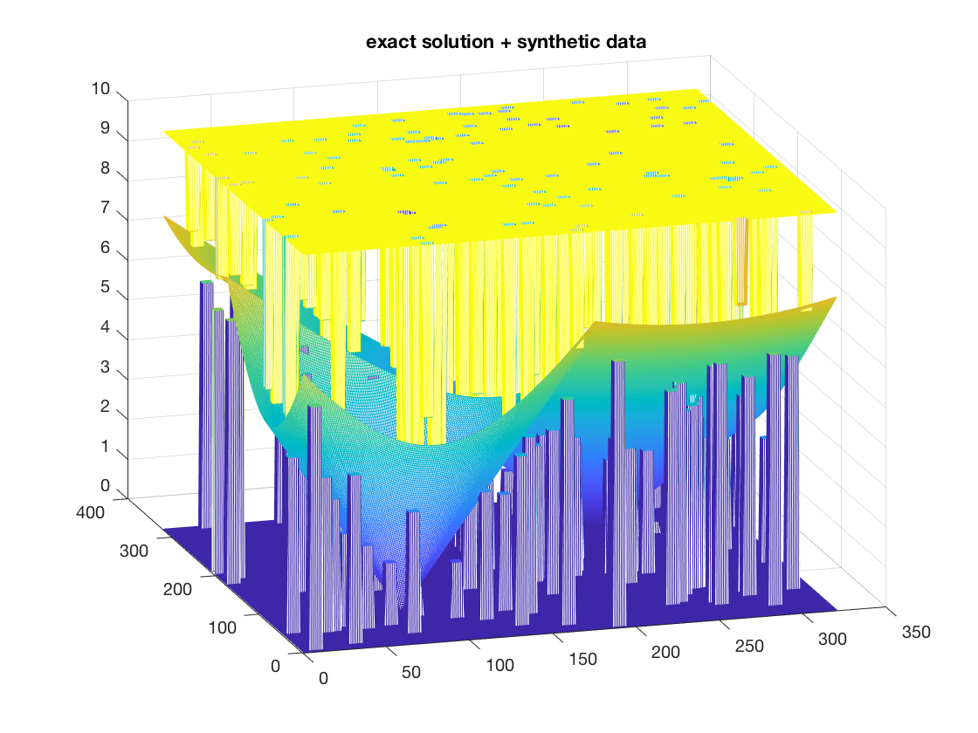
First test: exact solution and reconstructed
Synthetic data from exact solution Reconstructed fire arrival time

Slide 16
Method
Miminize the change in the gradient of fire arrival time
Mechanical model: fit an elastic plate in the gap
  => 4th order partial differential equation, well-known in computational mechanics, solve numerically by multigrid
Fills missing pixels, works well as long as data are consistent and a solution we like actually exists
But real data are far from consistent and nice.
Solution: soft constraints - upper and lower bounds are flexible rods, resist with force proportional to their displacement
  => 4th order nonlinear variational problem, solve by multigrid
  => statistical interpretation as maximum likelihood

Slide 17
Estimated Perimeters of the 2018 Sugarloaf fire from MODIS and VIIRS Active Fires Data

Slide 18
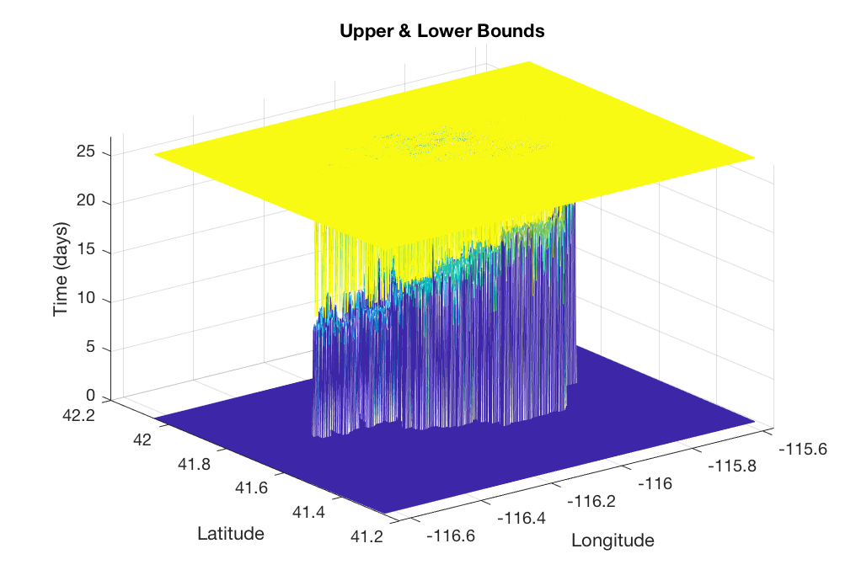
Data for the 2018 Sugarloaf Fire
All MODIS and VIIRS level 2 granules intersecting the domain, from Aug 15 to Sep 3 2018
Processed in the last detection of clear ground with fire and first detection of fire at a location
The interpolated fire arrival time should fit in the gap
Missing pixels are no problem
But false negatives and positives cause spikes intersecting the gap

Slide 19
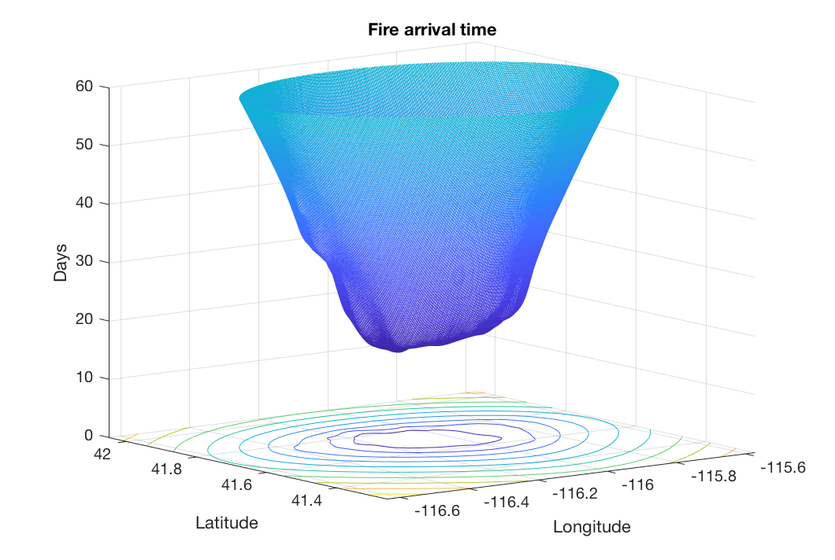
Data and solution for the Sugarloaf fire

Slide 20
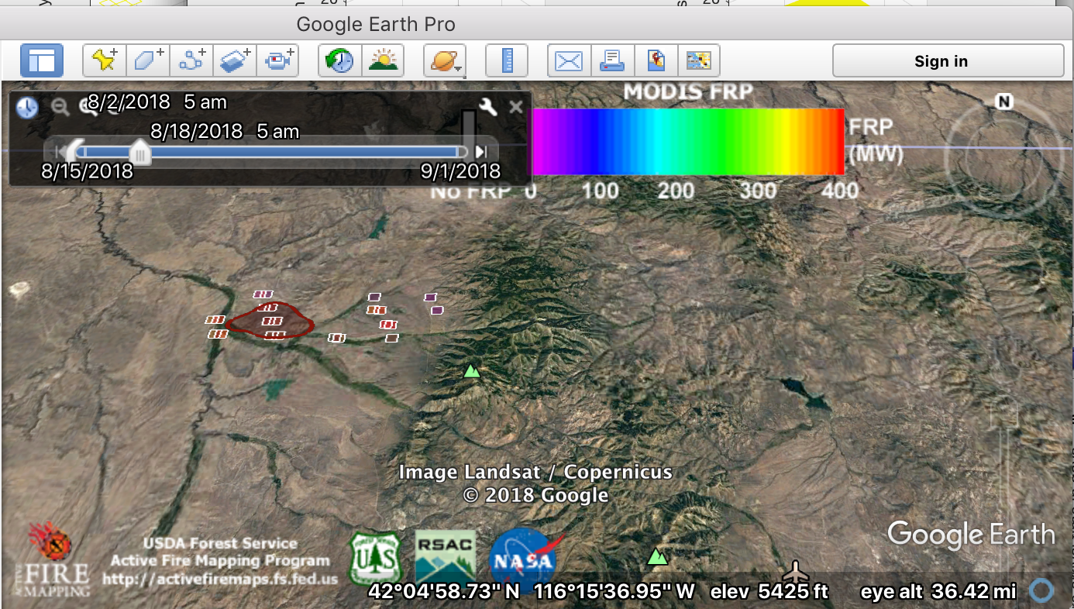

Slide 21
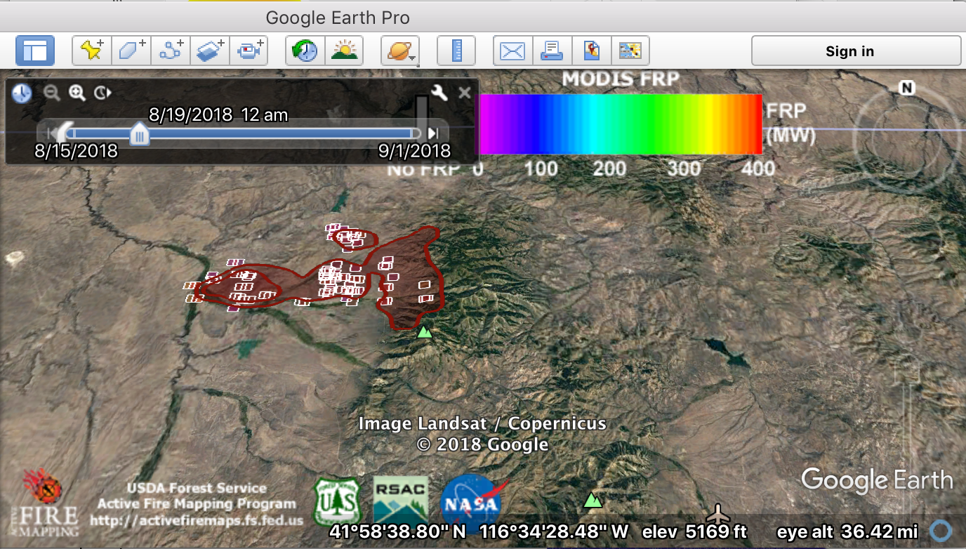

Slide 22
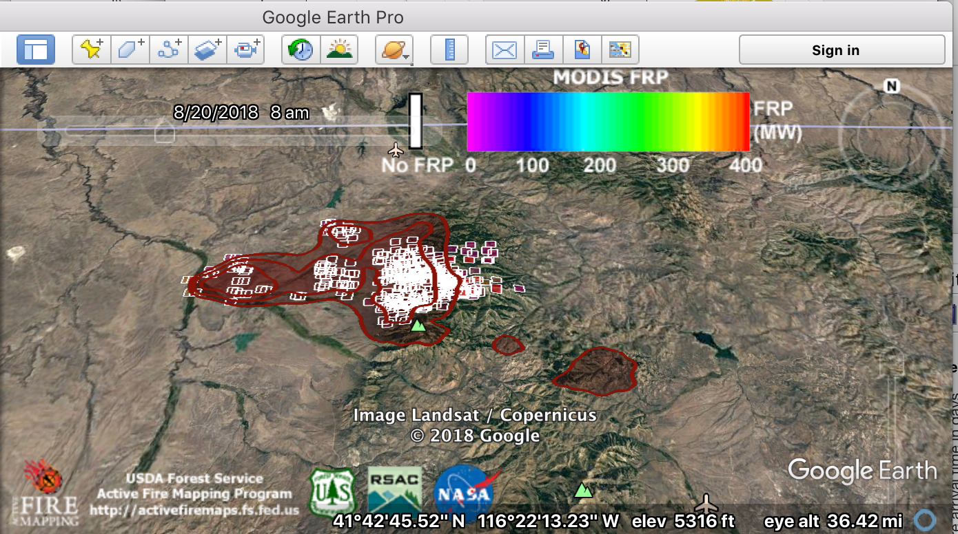

Slide 23
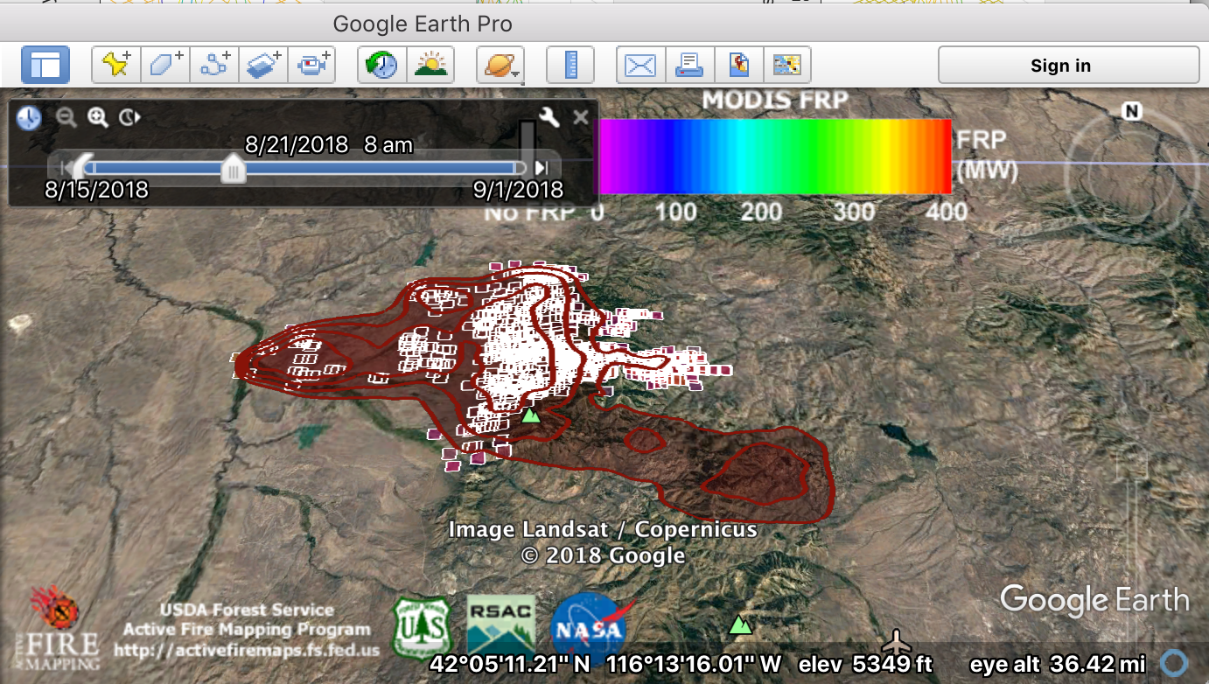

Slide 24
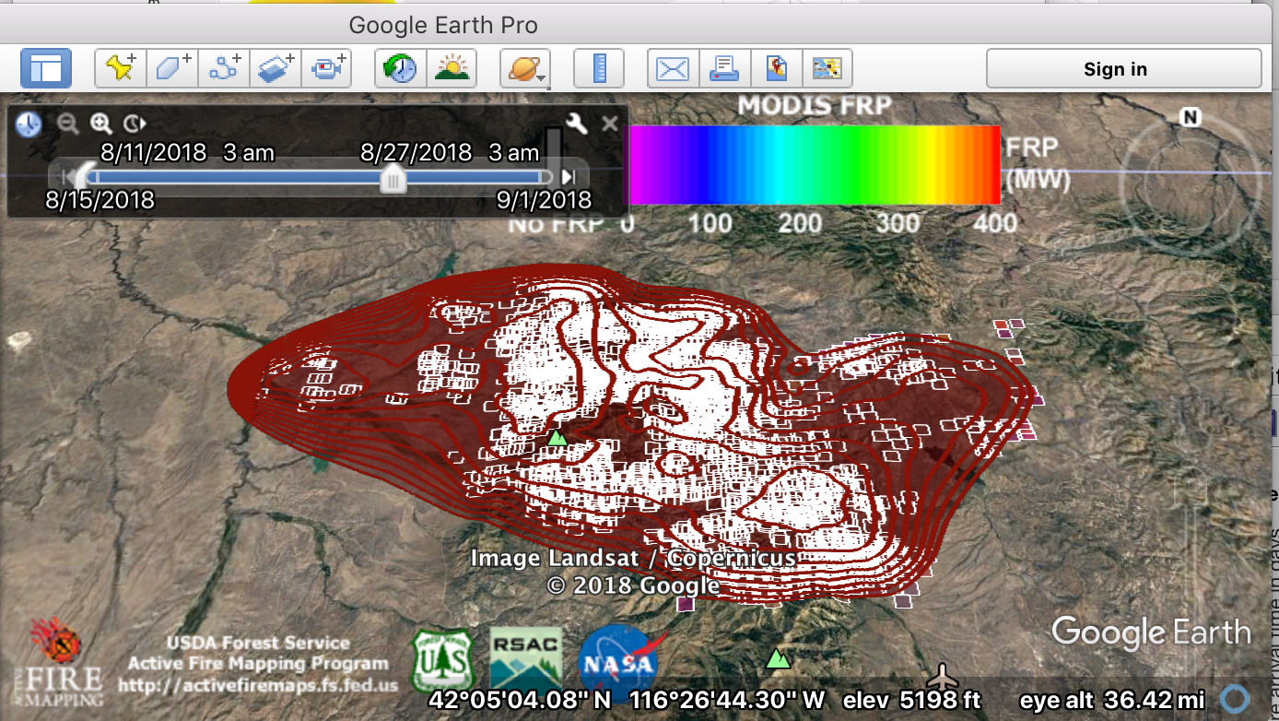

Slide 25
Plans and challenges
Automatic ignition in WRFx, the online system for WRF-SFIRE simulations.
Validations on more real fires, tuning the algorithms, parameters.
Add GOES-16 data. But
  Can’t get the fire product in near real time or by API – available on NOAA CLASS only, but CLASS wants a human at a keyboard to enter an order and wait for email with links to the data, which hopefully arrives in few days.
  Data from S3, a homegrown fire detection algorithm from raw infrared bands?
An efficient implementation over a large area (GPUs, parallel…)
Further development: effect of finite pixel size, sensitivity function, detection likelihood, accuracy bounds and theoretical analysis

